Slide 1

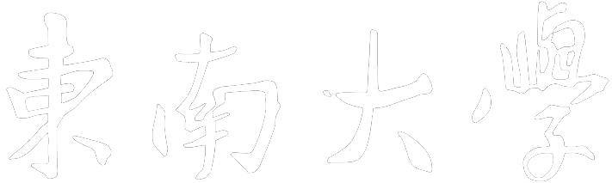

SOUTHEAST UNIVERSITY
Dynamic Snake Convolution
based on Topological Geometric Constraints for Tubular Structure Segmentation
Yaolei Qi
yaolei710@foxmail.com
Laboratory of Imaging Science and Technology, LIST
Southeaset University, China

Slide 2
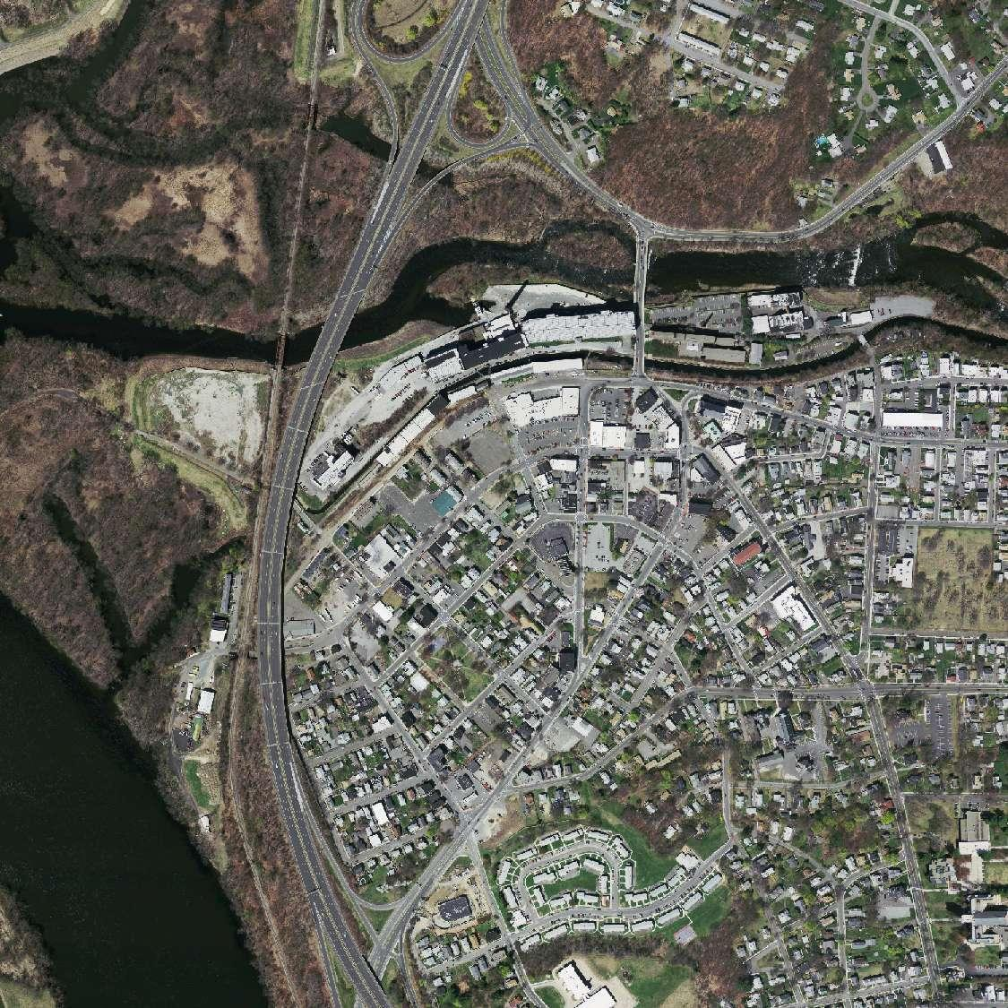
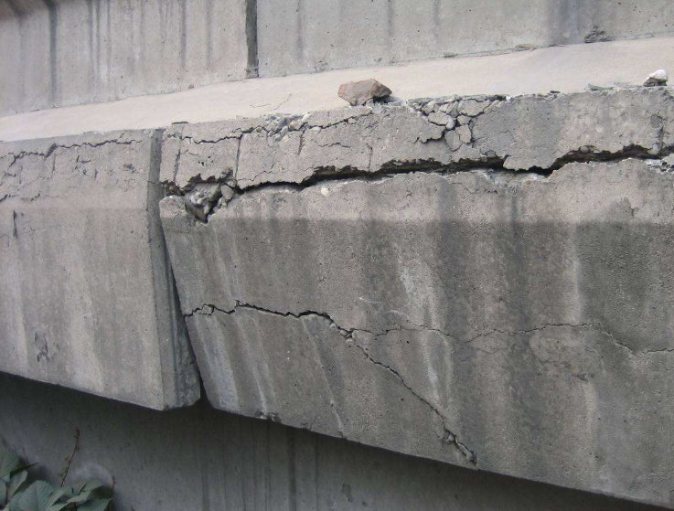

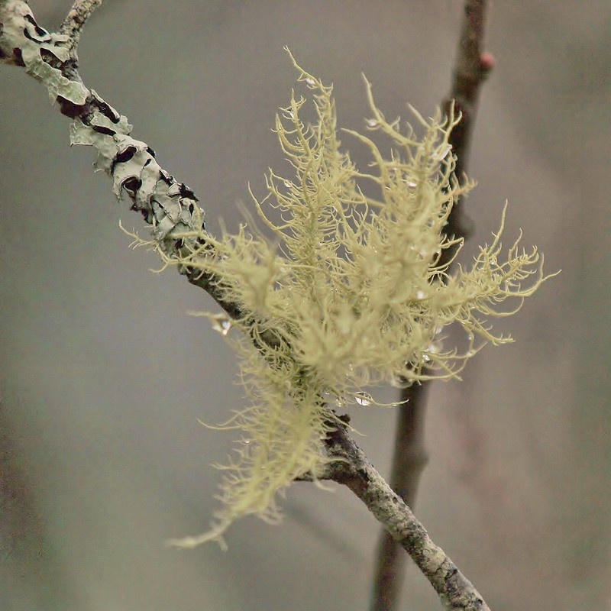

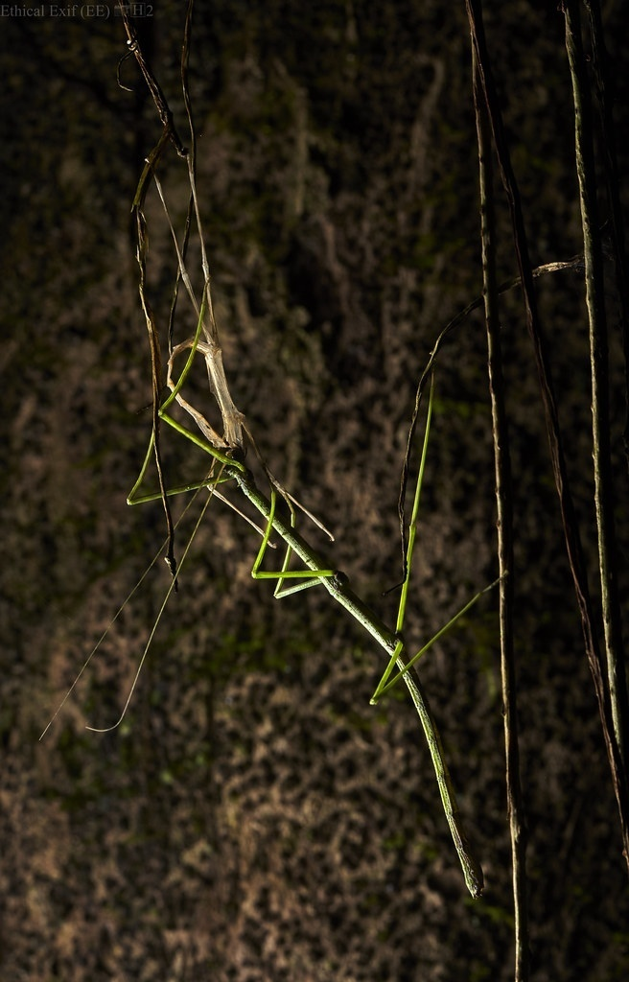
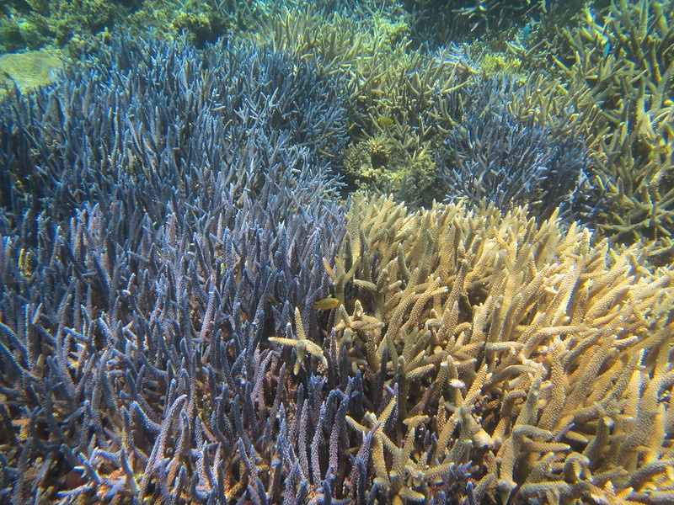
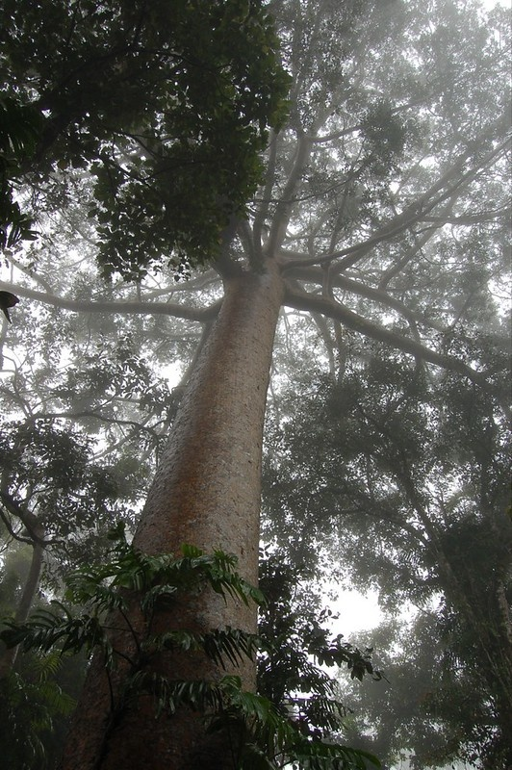
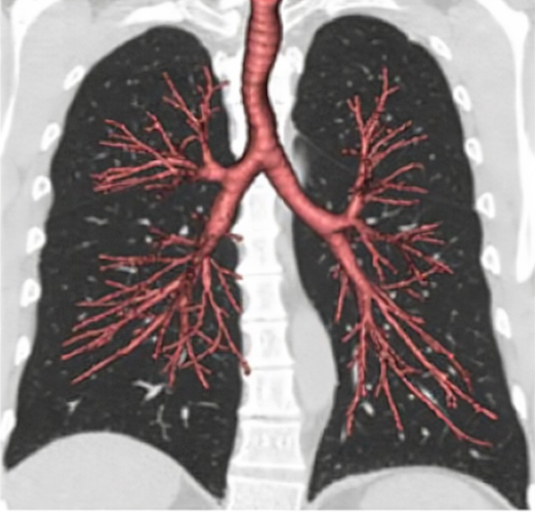
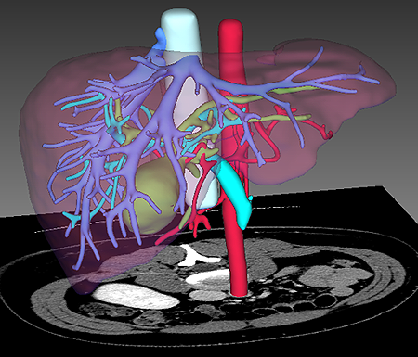
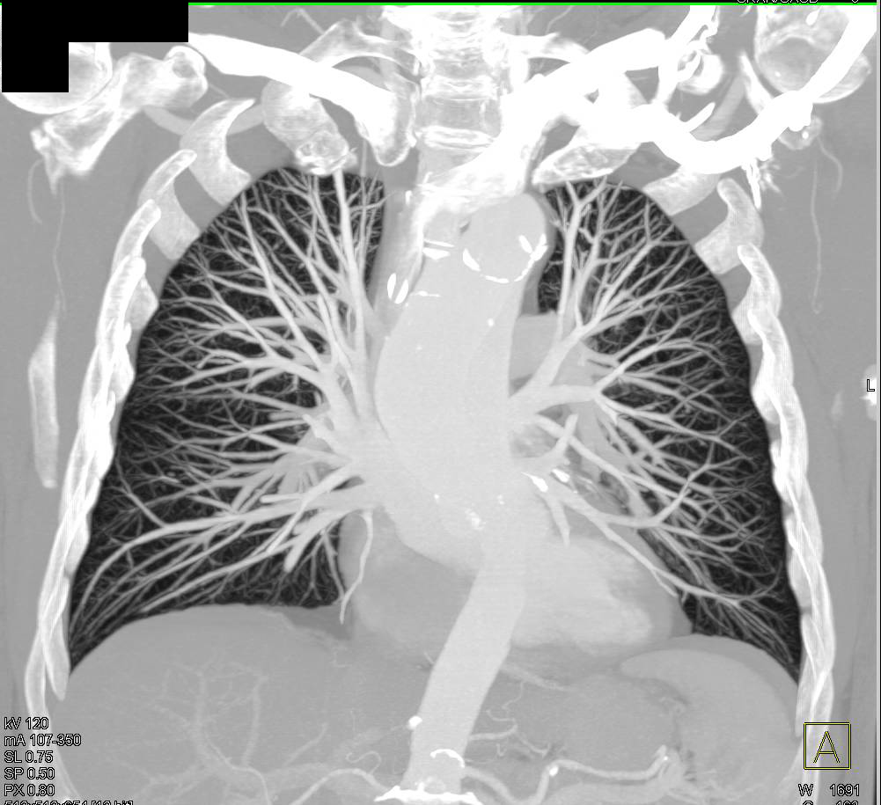
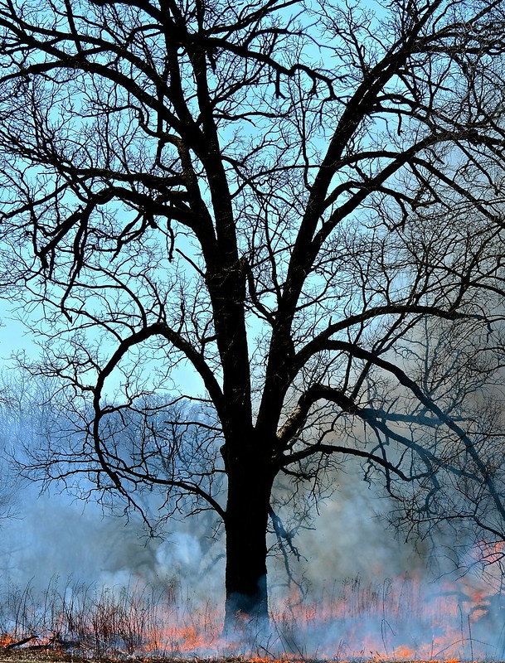

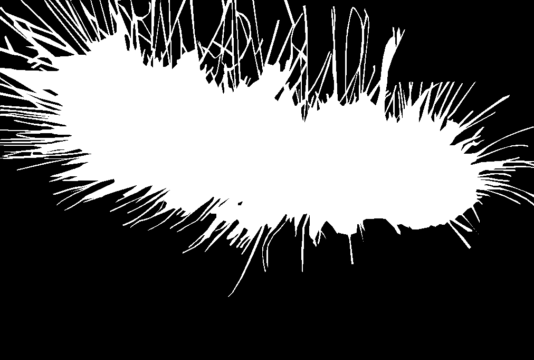
Ⅰ Background —— Tubular Structure
Tubular structures in medical image
Tubular structures in natural image

Slide 3
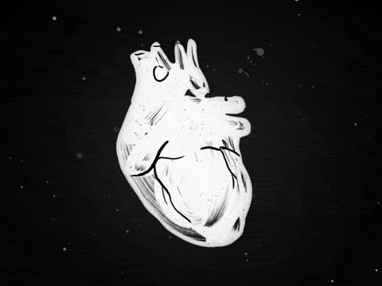

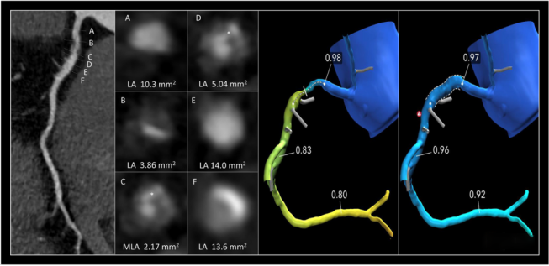
Ⅰ Importance —— Segmentation
Coronary Artery Disease
Number one in lethality
Coronary Artery Stenosis
Compress blood vessels
CT-FFR (Ko JACC 2017)
CT-FFR can detect stenosis non-invasively
CT-FFR depends on Computational Fluid Dynamics
CFD relies on well-delineated coronary lumen

Slide 4
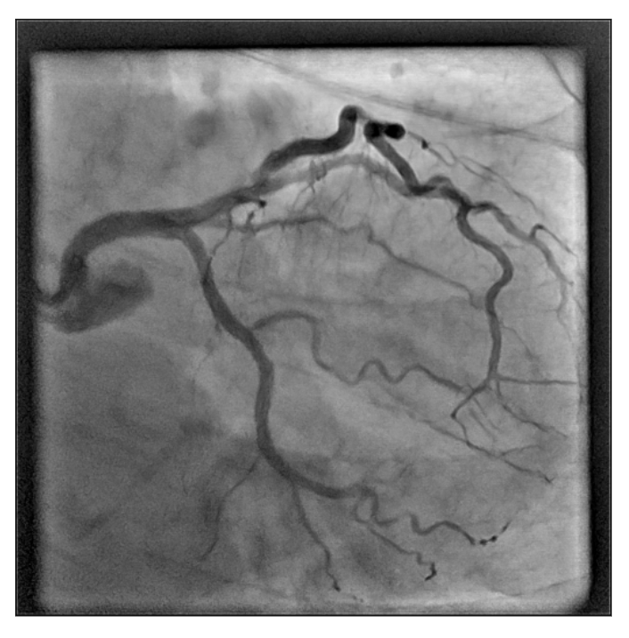
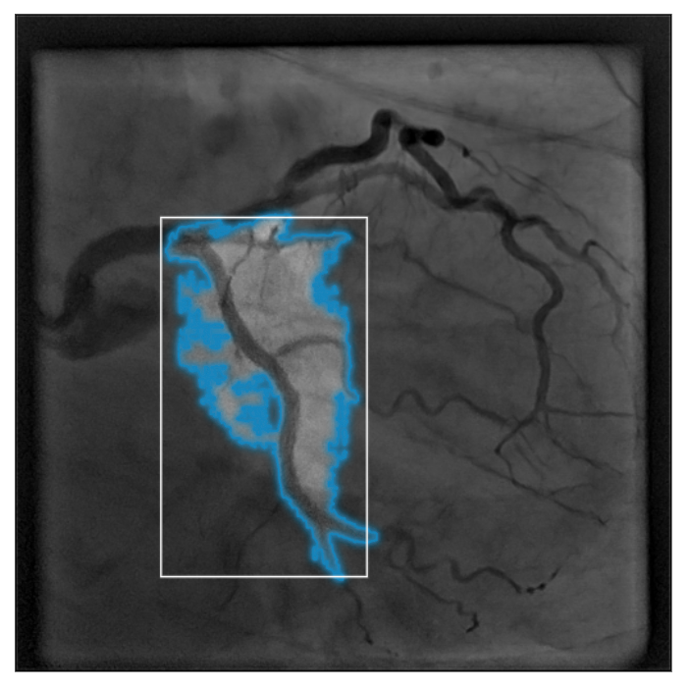
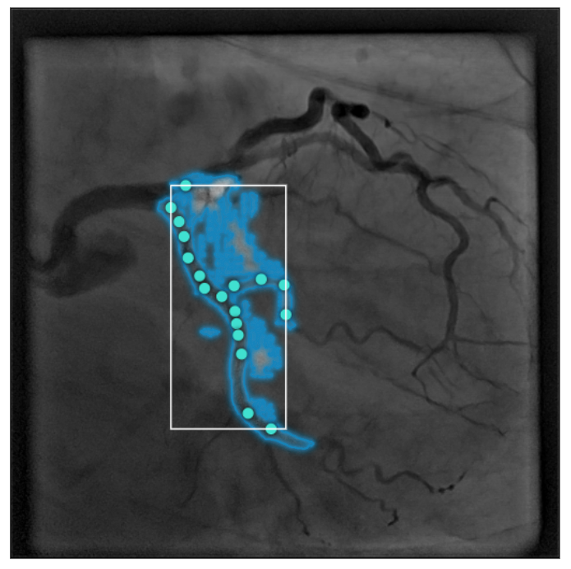
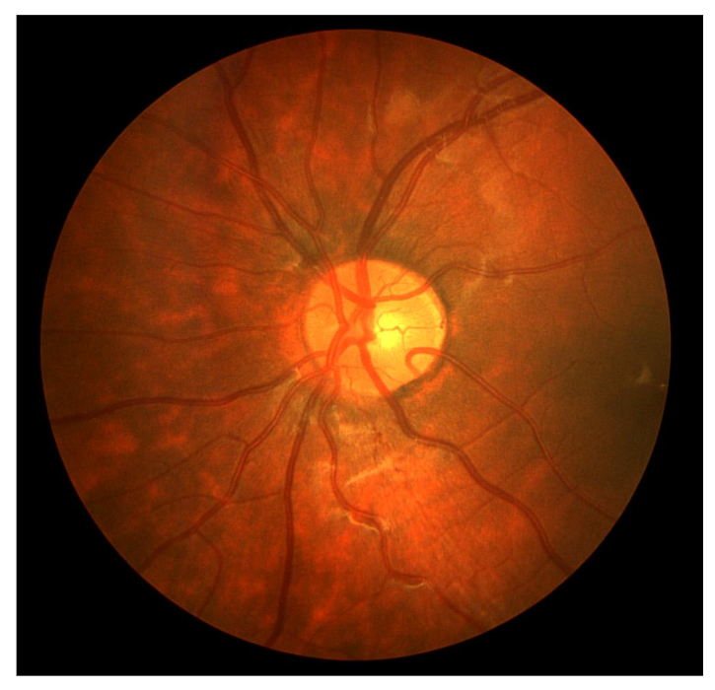
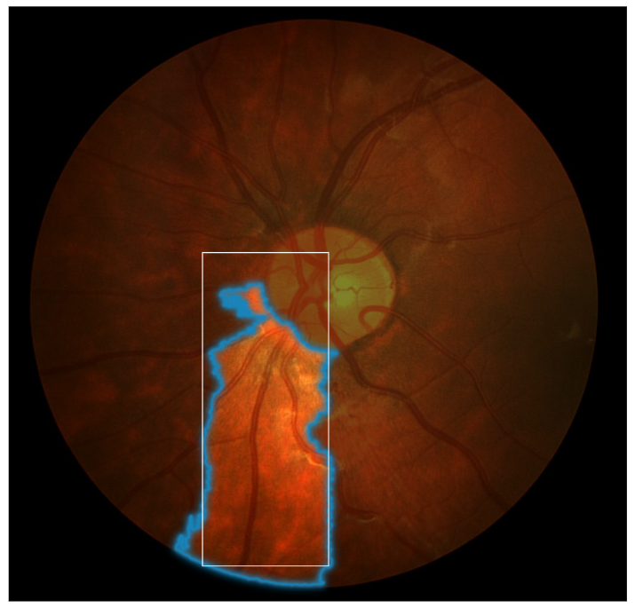
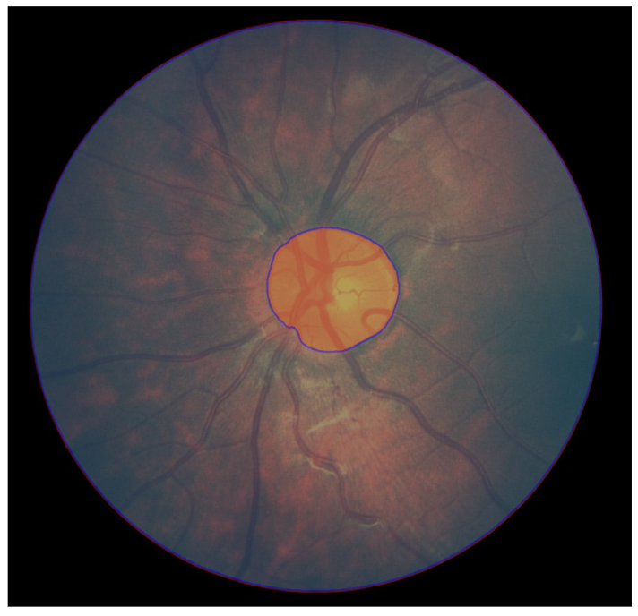
Ⅰ Challenge —— Segment Anything

Slide 5
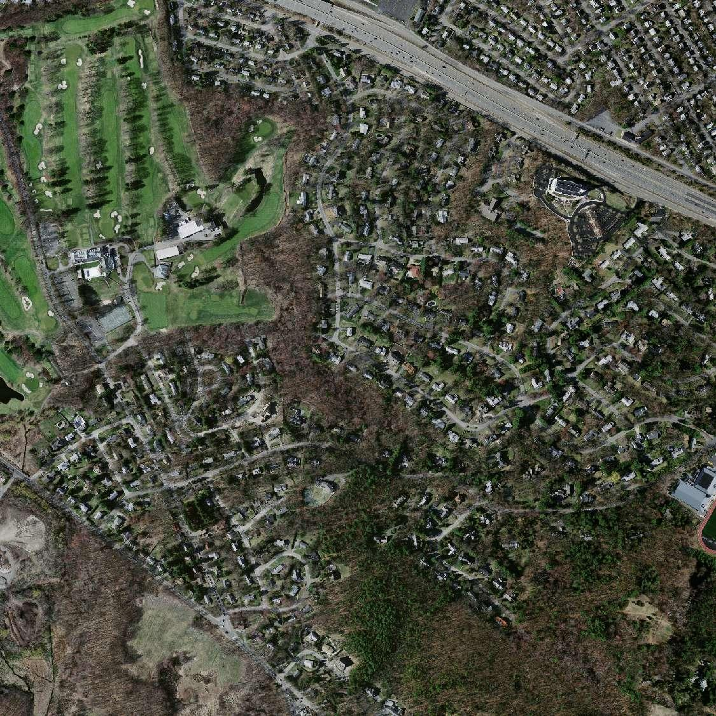
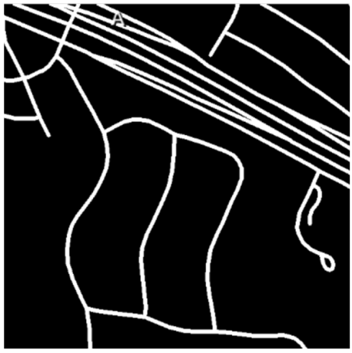
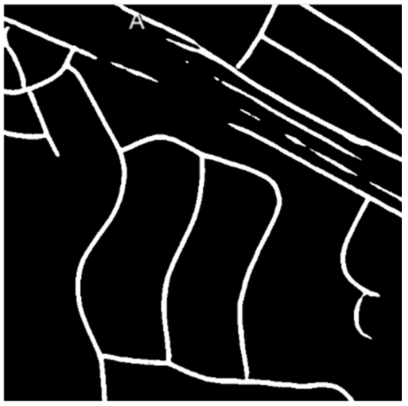
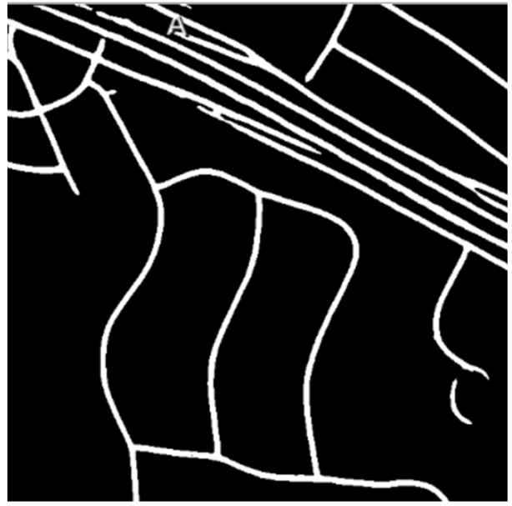
Ⅰ Challenge —— The inaccurate results
Groundtruth
DCU-Net
our DSCNet

Slide 6
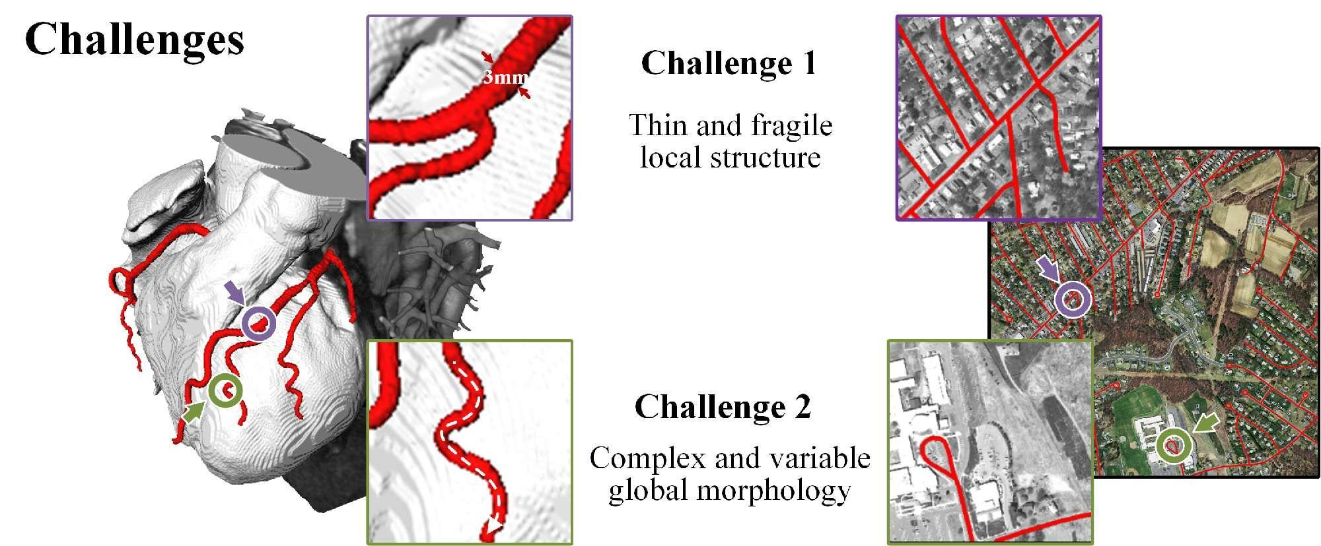
Ⅰ Challenges

Slide 7
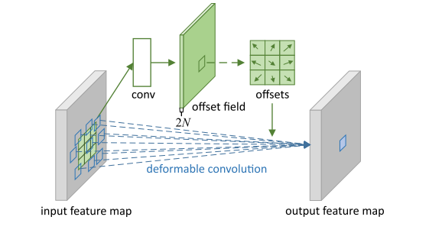
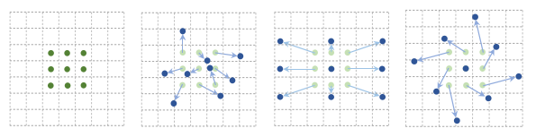
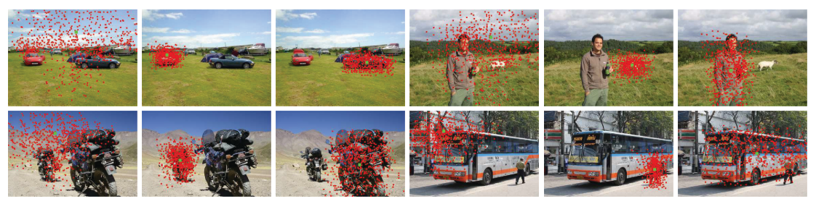
Ⅰ Motivation
DCN (Dai ICCV 2017)

Slide 8
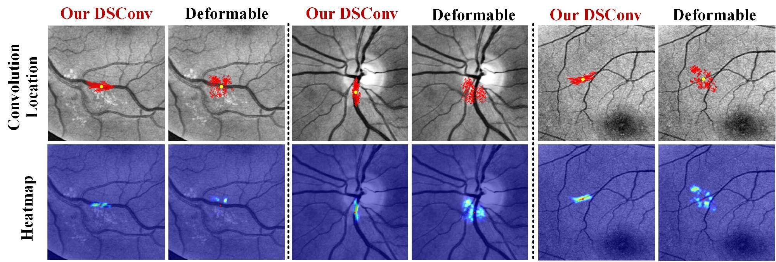
Ⅰ Motivation
Wandering outside the target
1. Since the <offset> is not constrained, which is learned completely freely
2. Due to the special features of the tubular structure, such as: ‘thin’, ‘wide distribution’...

Slide 9
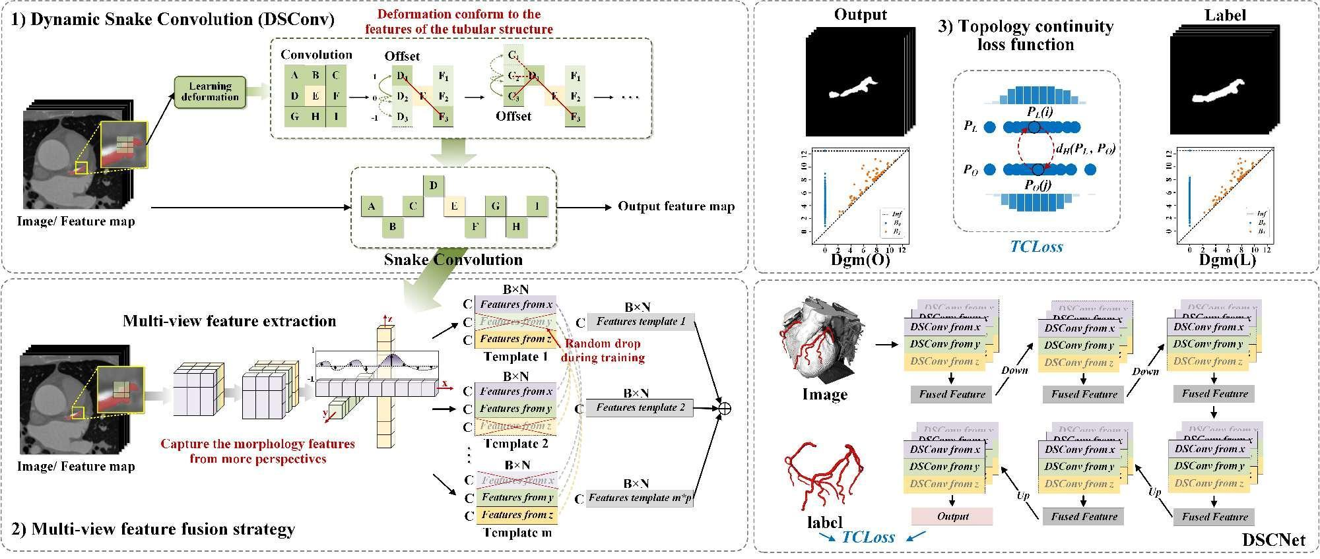
Ⅱ DSCNet
原文链接 https://arxiv.org/abs/2307.08388
知乎解析 https://zhuanlan.zhihu.com/p/644206121

Slide 10
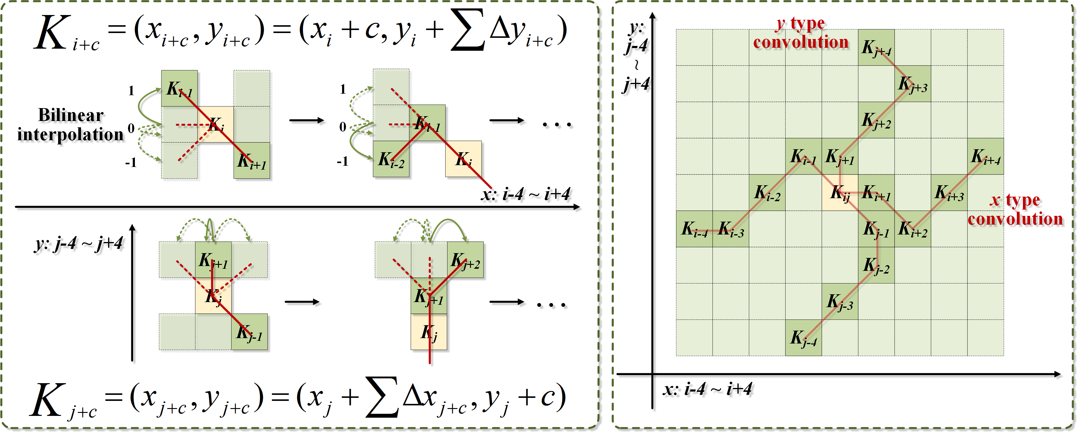
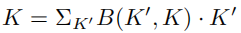
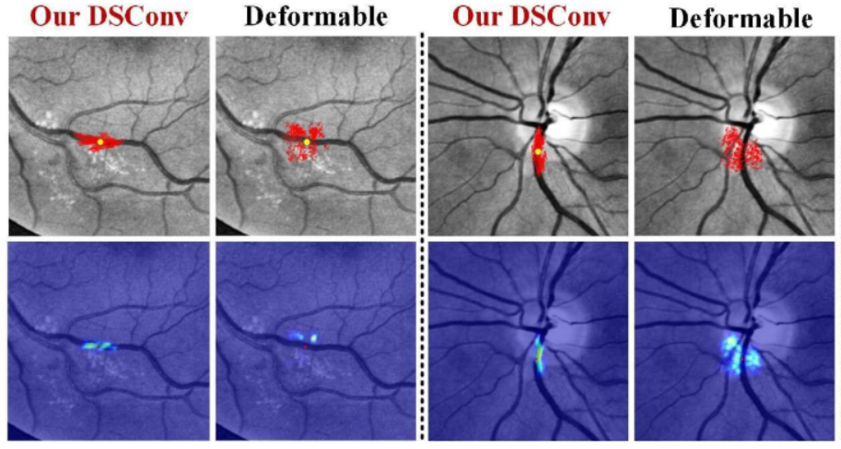
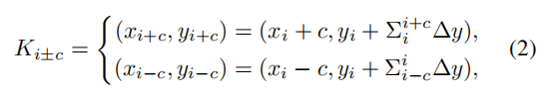
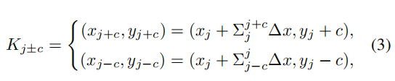
Ⅱ Dynamic Snake Convolution
1. Dynamic Snake Convolution:
Dynamically adapt to the tubular structure
2. Multi-view Feature Fusion Strategy:
Fuse Feature from multi perspective
3. Topological Continuity Constraint Loss:
Use Persistent Homology to constrain continuity

Slide 11
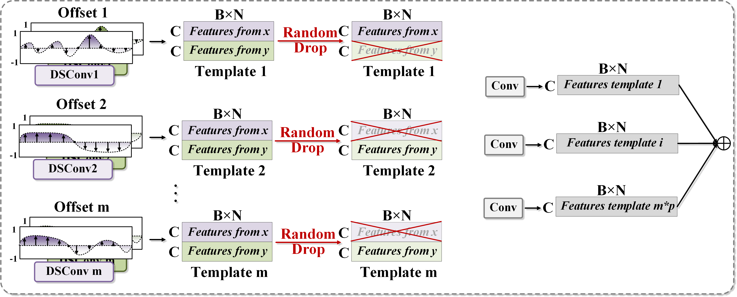
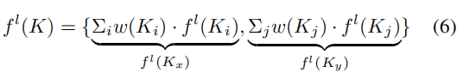
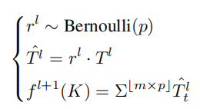
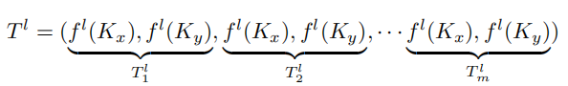
Ⅱ Multi-view Feature Fusion
1. Dynamic Snake Convolution:
Dynamically adapt to the tubular structure
2. Multi-view Feature Fusion Strategy:
Fuse Feature from multi perspective
3. Topological Continuity Constraint Loss:
Use Persistent Homology to constrain continuity

Slide 12
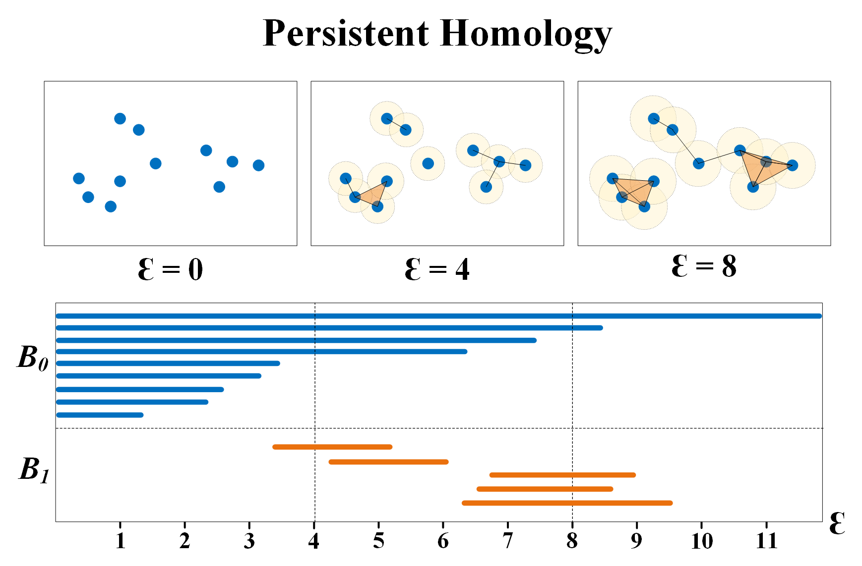
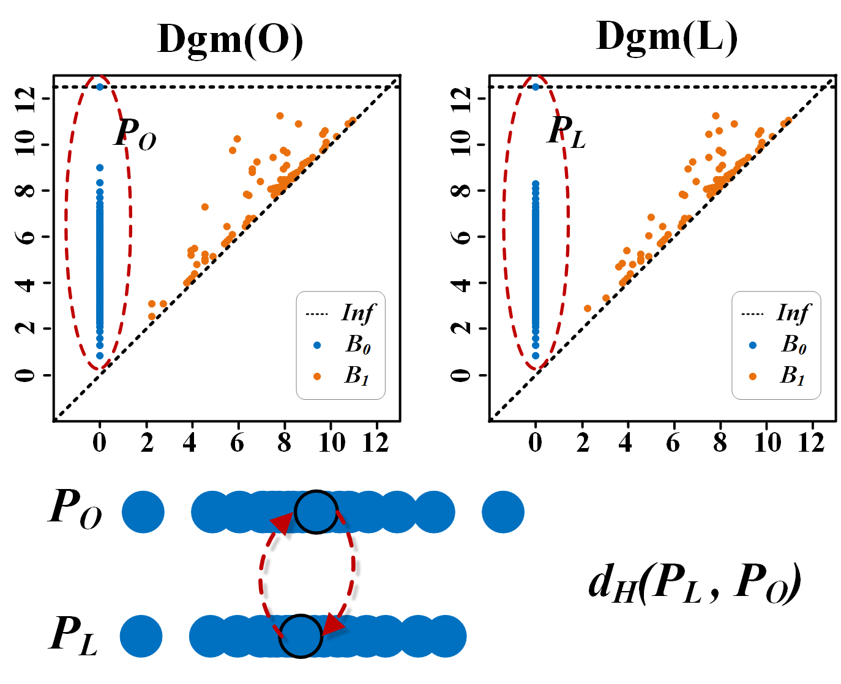
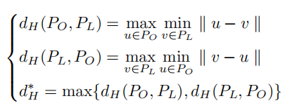
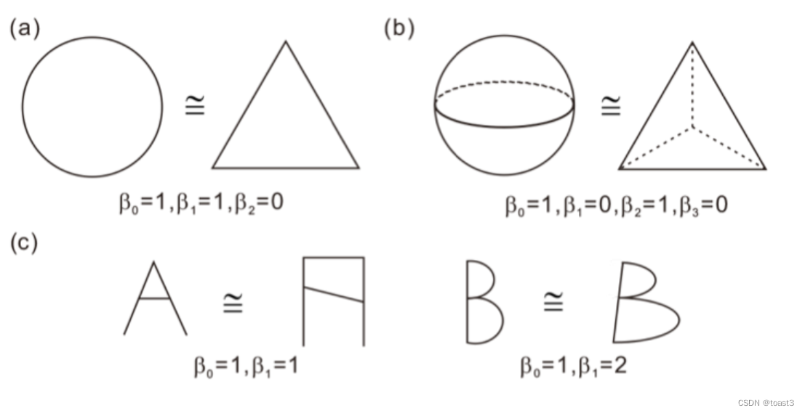
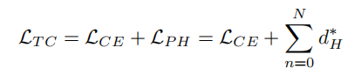
Ⅱ Persistent Homology
1. Dynamic Snake Convolution:
Dynamically adapt to the tubular structure
2. Multi-view Feature Fusion Strategy:
Fuse Feature from multi perspective
3. Topological Continuity Constraint Loss:
Use Persistent Homology to constrain continuity
Betti Data
[1] Xiaoling Hu, Fuxin Li, Dimitris Samaras, et al. Topology preserving deep image segmentation. Advances in neural information processing systems, 32, 2019.
[2] Chi-Chong Wong and Chi-Man Vong. Persistent homology based graph convolution network for fine-grained 3d shape segmentation. In Proceedings of the IEEE/CVF International Conference on Computer Vision (ICCV), pages 7098–7107, Oct 2021.

Slide 13
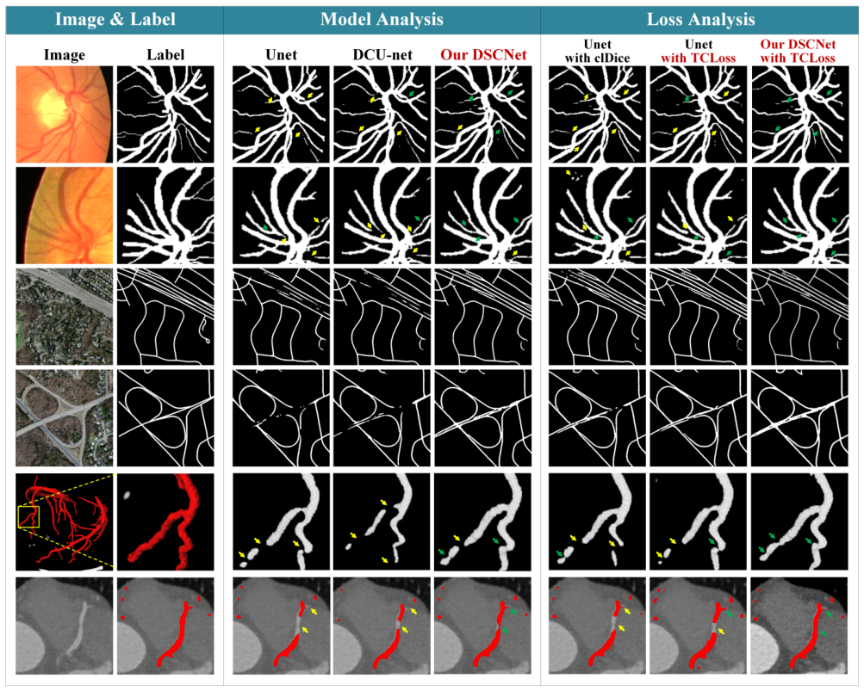
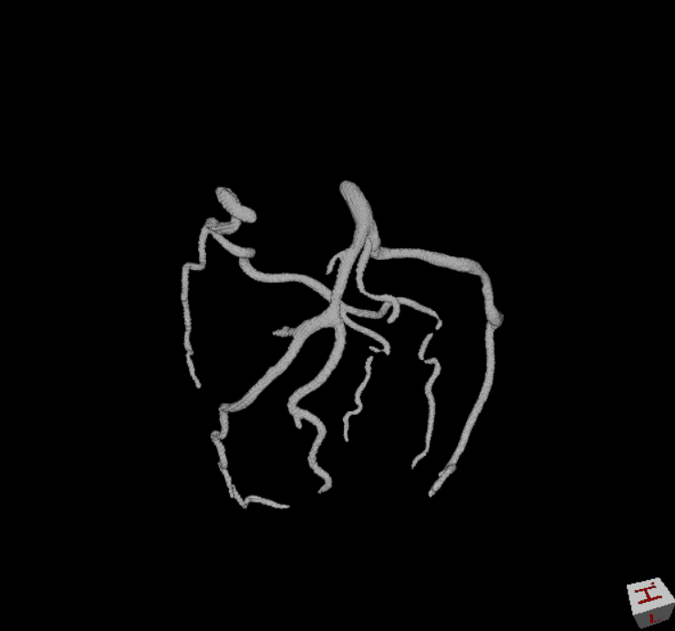
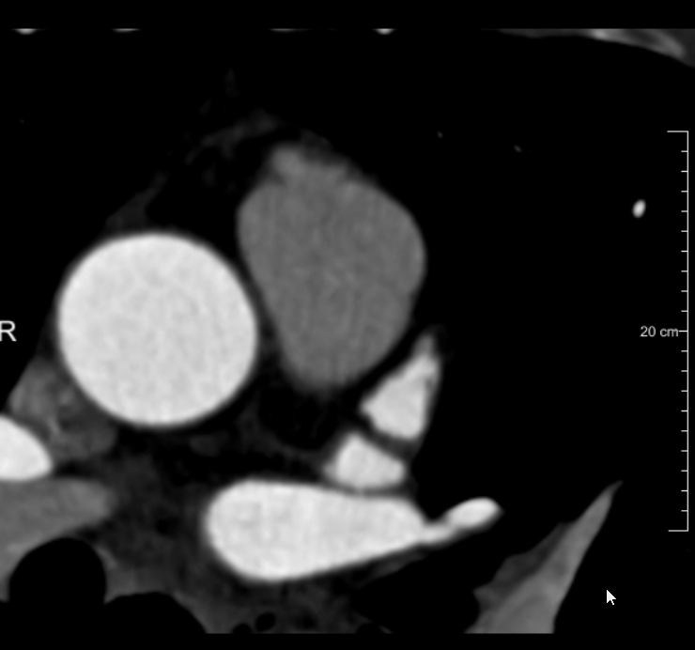
Ⅲ Results

Slide 14
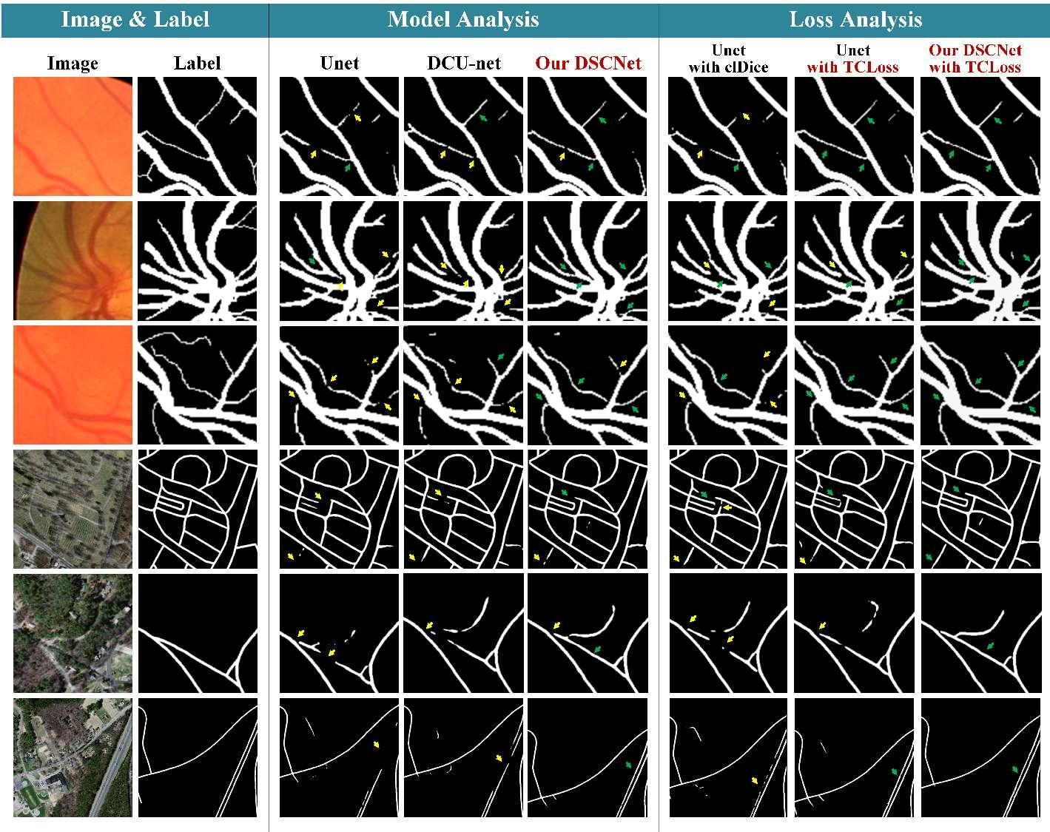
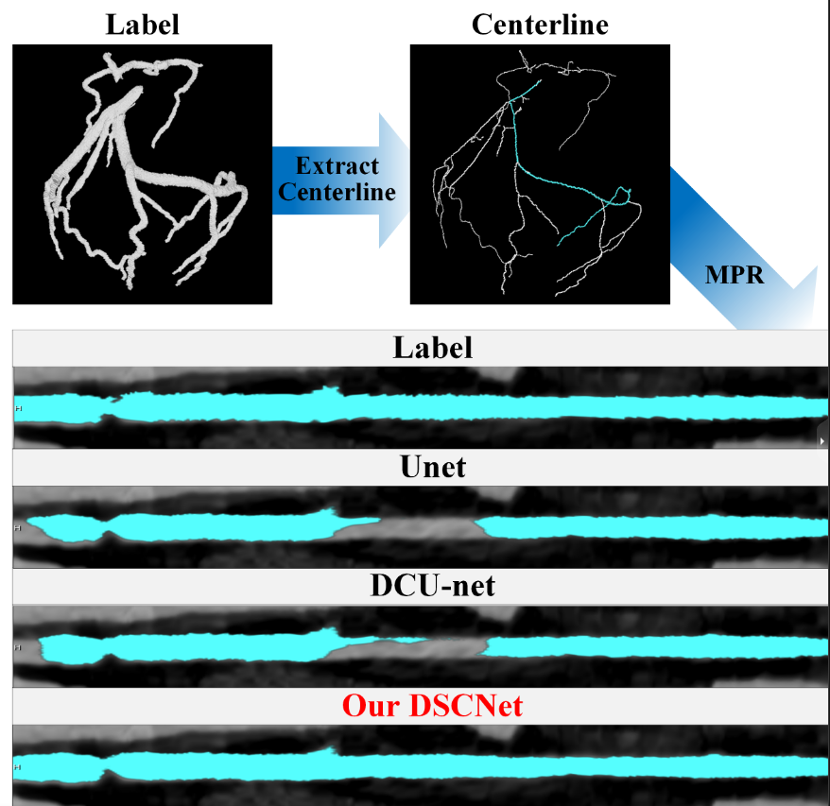
Ⅲ Results

Slide 15
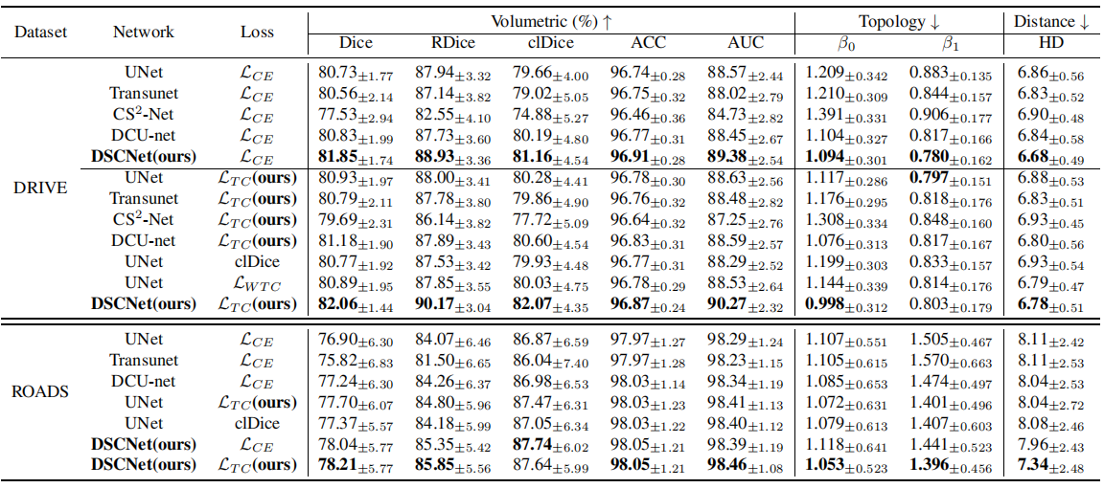
Ⅲ Results

Slide 16

Ⅲ Results

Slide 17


Ⅳ Future
https://github.com/YaoleiQi/DSCNet

Slide 18

SOUTHEAST UNIVERSITY
Yaolei Qi
yaolei710@foxmail.com
Wechat: 13082556710
Github: https://github.com/YaoleiQi

